Slide 1
Code Coverage

Slide 2

Code Coverage Measures
Code coverage is based on the control-structure of a piece of software respectively the flow of control achieved by the execution of a test case for that piece of software.
Eg - Code coverage counts the execution of items and relates this number to the total number of items in the piece of software in question. Such items are typically statements, branches, conditions, paths.

Slide 3
Statement Coverage
Statement coverage reports about execution of (executable) statements.
Statements can be assembler statements or statements of the C programming language, etc.
Statement coverage is sometimes called line coverage.
In case each line holds only one executable statement (what is automatically the case with assembler programs), the equivalence is obvious

Slide 4
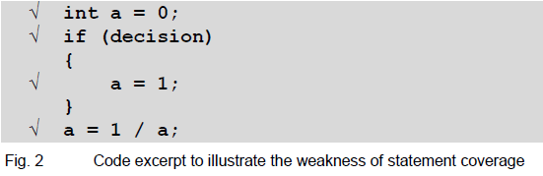
Statement Coverage Example
Statement coverage is a weak measure. To illustrate this, we consider the following example:
In the example below, we assume that all executable statements (respective lines) of the code excerpt were executed.
Hence we have 100% statement coverage.

Slide 5
Appraisal of Statement Coverage
As seen in the example, even if 100% statement coverage is achieved, severe bugs still can be present.
Therefore, please keep in mind what 100% statement coverage actually means: All statements were executed during the tests at least one time. Not more and not less.
We can assume, that 100% statement coverage is "better“ than, say 70% statement coverage, but the software quality achieved by 100% statement coverage is certainly not sufficient for a safety-critical project.
If you consider to apply statement coverage, to reach 100% is the minimal objective.
Statement coverage can be useful for detecting "dead code", i.e. code that cannot be executed at all.
Statement coverage can reveal missing test cases.

Slide 6
Branch Coverage / Decision Coverage
The terms "branch coverage“ and "decision coverage“ denote the same measure.
This measure relates to the decisions in a program, where program execution can take one out of two possible branches.
This is equivalent to the decision evaluating to both true and false.

Slide 7
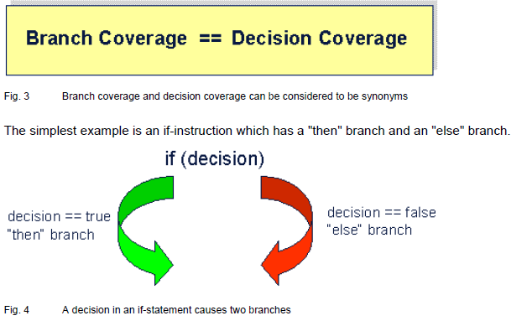
The definition of decision coverage is:
Every point of entry and exit in the program has been invoked at least once
Every decision in the program has taken on all possible outcomes at least once.

Slide 8
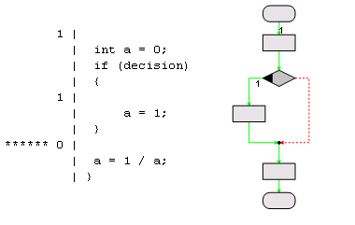
An if-Statement Has Always Two Branches
The right hand side of the figure above gives the flow-chart representation of the coverage information.
The else-branch with zero executions is in dotted format and marked in red. Executed branches are in green.
The branch coverage for the code excerpt is 50%.

Slide 9
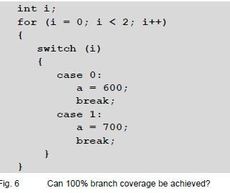
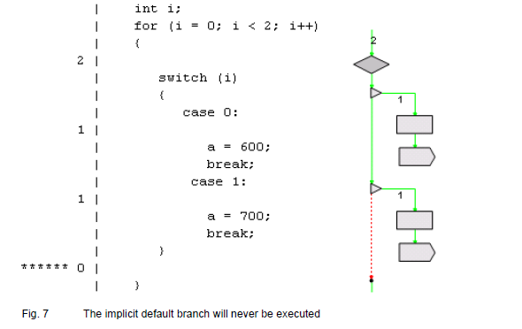
A Pathological Situation

Slide 10
Condition Coverage
A decision can be made up of one or more conditions which are combined by logical (i.e. Boolean) operators (AND, OR, NOT).
A condition is a Boolean expression containing no Boolean operator.
Conditions are also called atomic decisions.
Condition coverage measures to what extent conditions (i.e. atomic decisions) affect the outcome of a decision.
A lot of different condition coverage measures exist.

Slide 11
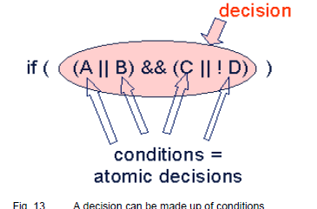
Condition Coverage

Slide 12
Complete and Incomplete Evaluation
Decisions consisting of logical combined conditions raise the problem of complete and incomplete evaluation.
Assume evaluation from left to right and as an example for a decision the decision "(A || B)". For a test case, in which A evaluates to true, it is not necessary to also evaluate B, because the outcome of the decision is true, regardless of the value of B.
Languages, where the compiler is not allowed to stop evaluation, have complete evaluation. C, C++, and Java normally have incomplete evaluation.

Slide 13
Simple Condition Coverage

Slide 14
Modified Condition / Decision Coverage
Every point of entry and exit in the program has been invoked at least once,
every condition in a decision in the program has taken all possible outcomes at least once,
every decision in the program has taken all possible outcomes at least once, and
each condition in a decision has been shown to independently affect that decision’s outcome.
A condition is shown to independently affect a decisions outcome by varying just that condition while holding fixed all other possible conditions.
If the decision is made up of n conditions, a set of test cases with pairs of test cases for each condition consists of at least (n+1) test cases. All test cases of such a set need to be executed to achieve 100% MC/DC. It is possible that different sets of test cases exist, that yield 100% MC/DC when executed.

Slide 15
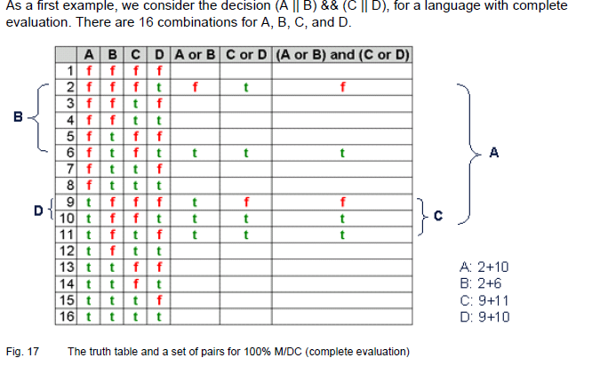

Slide 16
Path Coverage
A path is a sequence of branches taken during execution of a test case for the test object. Path coverage measures how many of the possible paths are executed during the tests.
The number of paths grows exponentially with the number of branches.
The problem stems from the potentially "infinite" number of loop executions, e.g. the loop "(for i=0; i < n; i++)" will be executed n times, and n could be a 32 bit integer variable or even bigger. Therefore, it is practically impossible to achieve 100% path coverage.

Slide 17
Boundary Interior Coverage
Boundary interior coverage classifies paths through a loop by the number of loop executions. Normally, three classes are defined:
(1) A class for all paths that do not execute the loop.
(2) A class for all paths that execute the loop exactly once.
(3) A class for paths that execute the loop at least two times.

Slide 18
The Value of Code Coverage
Essential Step / Reveals Untested Code
It is an essential step in the testing process to determine the code coverage that was reached during testing.
Code coverage measurement is important with respect to software quality, because it would reveal if e.g. a part of the code was never executed during testing.
This would be a hint for "dead code" or insufficient test cases.
The value of code coverage may be increased if not only the reached percentage is considered, but also single test cases are investigated.

Slide 19
Can Indicate Project Progress
If the total coverage of a project is monitored over time, this can be an indication for the progress of the project.
For instance:
(1) If the percentage of the total coverage grows, this could mean testing is catching up.
(2) If the percentage of the total coverage is getting smaller, this could mean new code is added without testing it appropriately.

Slide 20
Two Weaknesses of Code Coverage
However, even if you have reached the desired percentage, you must keep two weaknesses of code coverage in mind:
(1) Code coverage measurement cannot detect omissions, e.g. missing or incomplete code.
(2) Code coverage measurement is insensitive to calculations.

Slide 21
Cannot Detect Omissions
For instance, the specification for a function could state:
"The maximum input value the algorithm can handle is 500. If the input value is greater than 500, it shall be set to 500."
If the implementation of the function misses to check the input value, and therefore also misses to take an appropriate action if the value is greater 500, code coverage measurement will not detect the missing check, even if a test case with the input value 501 is executed.

Slide 22
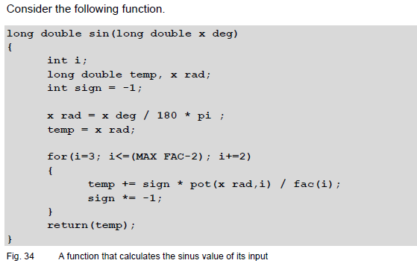
Insensitive to Calculations

Slide 23
Recommendations
Should Be Reached by Functional Test Cases
Should Be Done During Module/Unit Testing
Select the Right Measure

Slide 24
Conclusion
Be aware of the confusing nomenclature.
Don’t rate the quality of your code too high if you have reached 100%.

